Slide 1
Software Maintenance and Software Metrics
Unit-V

Slide 2
Need for Software maintenance
Maintenance models
SCM
Version Control
SCM process
Software Configuration Items
Scope of Software Metrics
Classification of metrics
Measuring Process and Product attributes
Direct and Indirect measures
Reliability
Software Quality Assurance
Standards
Taxonomy

Slide 3
Software Maintenance
Software Maintenance is the process of modifying a software product after it has been delivered to the customer.
The main purpose of software maintenance is to modify and update software applications after delivery to correct faults and to improve performance.
Software maintenance is a part of the Software Development Life Cycle.

Slide 4
NEED FOR SOFTWARE MAINTENANCE
Correct errors
Change in user requirement with time
Changing hardware/software requirements
To improve system efficiency
To optimize the code to run faster
To modify the components
To reduce any unwanted side effects.

Slide 5
Types of Software Maintenance
1. Corrective Maintenance
Corrective maintenance aims to correct any remaining errors regardless of where they may cause specifications, design, coding, testing, and documentation, etc.
2. Adaptive Maintenance
It contains modifying the software to match changes in the ever-changing environment.

Slide 6
3. Preventive Maintenance
It involves the concept of reengineering & reverse engineering in which an old system with old technology is re-engineered using new technology. This maintenance prevents the system from dying out.
4. Perfective Maintenance
It defines improving processing efficiency or performance or restricting the software to enhance changeability.
This may contain enhancement of existing system functionality, improvement in computational efficiency, etc.

Slide 7
Software Maintenance Model
Iterative Enhancement Model,
Osborne’s Model,
Quick-fix Model,
Reuse-Oriented Model
Boehm’s Model

Slide 8
Iterative Enhancement Model
Iterative enhancement model considers the changes made to the system are iterative in nature.
This model incorporates changes in the software based on the analysis of the existing system.
It assumes complete documentation of the software is available in the beginning.
Moreover, it attempts to control complexity and tries to maintain good design

Slide 9
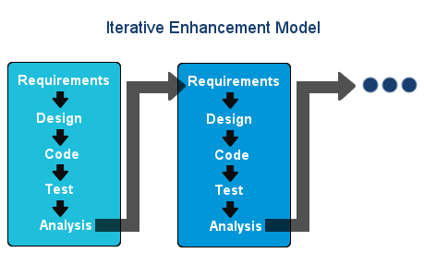

Slide 10
Quick-Fix Model
This is an ad hoc approach used for maintaining the software system.
The objective of this model is to identify the problem and then fix it as quickly as possible.
The advantage is that it performs its work quickly and at a low cost.
This model is an approach to modify the software code with little consideration for its impact on the overall structure of the software system.

Slide 11
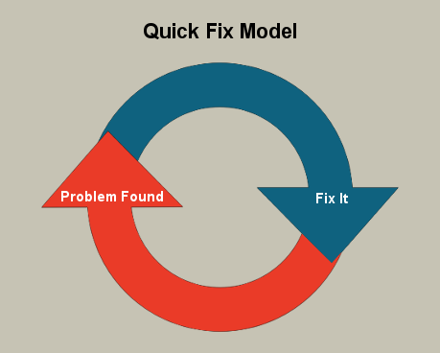

Slide 12
Osborne’s model
Osborne’s model is involved with the reality of the maintenance environment.
In Osborne’s point of view, technical problems, which emerge during maintenance are because of weak communication and control between management. Osborne suggests four strategies to tackle these issues, which are given below:
1. A quality assurance program is required to establish quality assurance requirements.
2. Managers need to be provided with feedback through performance reviews.
3. Maintenance requirements need to be included in the change specification.
4. A metrics needs to be developed in order to verify that the maintenance
goals have been met

Slide 13
Reuse-oriented Model
The reuse-oriented model assumes that existing program components could be reused.
The parts of the old/existing system that are appropriate for reuse are identified and understood, in Reuse Oriented Model.
These parts are then go through modification and enhancement, which are done on the basis of the specified new requirements.
The final step of this model is the integration of modified parts into the new system.

Slide 14
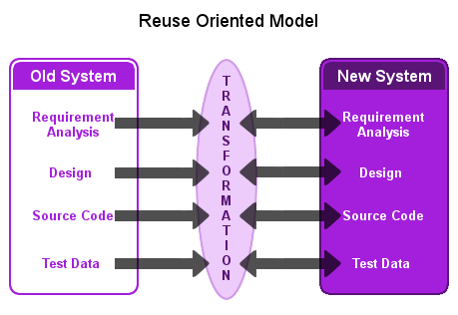

Slide 15
Boehm’s model is based on Economic Models and Principles.
It represents the maintenance process in a closed loop cycle, wherein changes are suggested and approved first and then are executed.
The use of economic models helps us to better understand the problem and modify productivity in maintenance

Slide 16
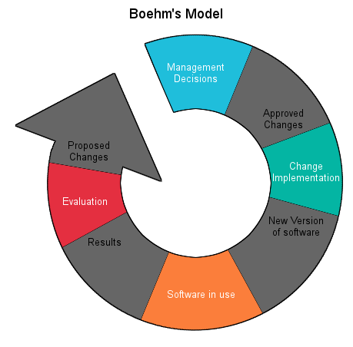

Slide 17
SCM
Software Configuration Management(SCM) is a process to systematically manage, organize, and control the changes in the documents, codes, and other entities during the Software Development Life Cycle.
The primary goal is to increase productivity with minimal mistakes.
Software Configuration Management is the ability to control and manage change in a software project.

Slide 18
Need for Configuration Management
There are multiple people working on software which is continually updating.
It may be a case where multiple version, branches, authors are involved in a software config project, and the team is geographically distributed and works concurrently
Changes in user requirement, policy, budget, schedule need to be accommodated.
Software should able to run on various machines and Operating Systems
Helps to develop coordination among stakeholders
SCM process is also beneficial to control the costs involved in making changes to a system

Slide 19
Version Control
Version control (also known as revision control or source control) is a category of processes and tools designed to keep track of multiple different versions of software, content, documents, websites and other information in development.
Is the practice of tracking and managing changes to software code.
Version control systems are software tools that help software teams manage changes to source code over time.

Slide 20
Types of Version Control Systems:
Local Version Control Systems
Centralized Version Control Systems
Distributed Version Control Systems

Slide 21
SCM Process
It uses the tools which keep that the necessary change has been implemented adequately to the appropriate component. The SCM process defines a number of tasks:
Identification of objects in the software configuration
Version Control
Change Control
Configuration Audit
Status Reporting

Slide 22
Software Configuration Items
A software configuration item is generated as part of the software engineering process.
Artifacts produced during the software configuration process are called Software Configuration Items (SCIs).
Some examples of software configuration items are:
Management plans (Project Plan, Test Plan, etc.)
Specification (Requirements, Design, Test Case, etc.)
Customer documentation (Implementation Manual, User Manuals,Operations Manuals, On-Line help files)

Slide 23
Source code (PL/I Fortran, COBOL, Visual Basic, Visual C, etc.)
Executable code (Machine readable object code, exe’s, etc.)
Libraries (Runtime Libraries, Procedures, API’s DLL’s etc.)
Database (Data being Processed, Data a program requires, test data, Regression test data, etc.)
Production documentation

Slide 24
Software Metric
A software metric is a measure of software characteristics which are measurable or countable.
Software metrics are valuable for many reasons, including measuring software performance, planning work items, measuring productivity, and many other uses.

Slide 25
Metrics
A metric is a measurement of the level that any impute belongs to a system product or process. There are 4 functions related to software metrics:
Planning
Organizing
Controlling
Improving

Slide 26
Characteristics of software Metrics:
Quantitative: Metrics must possess quantitative nature. It means metrics can be expressed in values.
Understandable: Metric computation should be easily understood ,the method of computing metric should be clearly defined.
Applicability: Metrics should be applicable in the initial phases of development of the software.
Repeatable: The metric values should be same when measured repeatedly and consistent in nature.
Economical: Computation of metrics should be economical.
Language Independent: Metrics should not depend on any programming language.

Slide 27
Scope of Software Metrics
Software metrics contains many activities which include the following −
Cost and effort estimation
Productivity measures and model
Data collection
Quantity models and measures
Reliability models
Performance and evaluation models
Structural and complexity metrics
Capability – maturity assessment
Management by metrics
Evaluation of methods and tools

Slide 28
Classification of Software Metrics:
There are 3 types of software metrics:
Product Metrics: Product metrics are used to evaluate the state of the product, tracing risks and undercovering prospective problem areas. The ability of team to control quality is evaluated.
Process Metrics: Process metrics pay particular attention on enhancing the long term process of the team or organization.
Project Metrics: The project matrix describes the project characteristic and execution process.
Number of software developer
Staffing pattern over the life cycle of software
Cost and schedule
Productivity

Slide 29
Measuring Process and Product attributes
In software measurement we can divide entities into two categories: products and processes.
Product and process entities are of different types.
For example, specifications, requirements, designs, test sets, code are all product entities and their parts are also product entities.
On the other hand, we can define process entities as single phases, activities, and resources used during a project.
Product and process entities have specific attributes. For example, product attributes include complexity, size, cohesion, reliability, coupling, etc. Process attributes consist of time, cost, effort, etc.

Slide 30
Direct and Indirect measures
Software measurement is a quantified attribute of a characteristic of a software product or the software process.
Software measurements are of two categories,
1. Direct measures
2. Indirect measures.
Direct measures include software processes like cost and effort applied and products like lines of code produced, execution speed, and other defects that have been reported.
Indirect measures include products like functionality, quality, complexity, reliability, maintainability, and many more.

Slide 31
Software Reliability
Software reliability is defined in statistical terms as "the probability of failure-free operation of a computer program in a specified environment for a specified time".
software Reliability is an essential connect of software quality, composed with functionality, usability, performance, serviceability, capability, installability, maintainability, and documentation.
Software safety is a software quality assurance activity that focuses on the identification and assessment of potential hazards that may affect software negatively and cause an entire system to fail.

Slide 32
Software Quality Assurance (SQA)
Software Quality Assurance (SQA) is simply a way to assure quality in the software. It is the set of activities which ensure processes, procedures as well as standards are suitable for the project and implemented correctly.
Software Quality Assurance is a process which works parallel to development of software. It focuses on improving the process of development of software so that problems can be prevented before they become a major issue.
Software Quality Assurance is a kind of Umbrella activity that is applied throughout the software process.

Slide 33
SQA Activities
Prepares an SQA plan for a project
Participates in the development of the project's software process description
Reviews software engineering activities to verify compliance with the defined software process
Audits designated software work products to verify compliance with those defined as a part of the software process
Ensures that deviations in software work and work products are documented and handled according to a documented procedure
Records any noncompliance and reports to senior management

Slide 34
Benefits of SQA
SQA produces high quality software.
High quality application saves time and cost.
SQA is beneficial for better reliability.
SQA is beneficial in the condition of no maintenance for a long time.
High quality commercial software increase market share of company.
Improving the process of creating software.
Improves the quality of the software.

Slide 35
SQA Standards
Standards are documented agreements containing technical specifications or other precise criteria to be used consistently as rules, guidelines, or definitions of characteristics.
ISO 9001 is the quality assurance standard that applies to software engineering.
Standards: Standards are documented agreements containing technical specifications or other precise criteria to be used consistently to ensure that materials, products, processes and services are fit for their purpose

Slide 36
ISO Standard Series and Some Other Standards
The ISO Standard Series includes the following Systems Standards indicating their specific purposes:
ISO 9000: Quality Management and Quality Assurance Standards Guidelines for Selection and Use
ISO 9001: Model for Quality Assurance in Design/Development, Production Installation, and Servicing.
ISO 9002: Model for Quality Assurance in Production and Installation.

Slide 37
ISO Standard Series and Some Other Standards
ISO 9003: Model for Quality Assurance in Final Inspection and Test.
ISO 9004: Generic Guidelines for Quality Management and Systems.
ISO 9004-2: Guidelines for Services
ISO 14001: Environmental Management System Guidelines for Principles, Systems, and Supporting Techniques.

Slide 38
TAXONOMY
CASE tools stand for Computer Aided Software Engineering tools. We can define them as computer based programs that increase the productivity of analysts.
Generally, Case tools can be classified by its function, also by their role as instruments for managers, by their use in the various steps of software engineering process, by its environment.
Let us now study the various types of tools available. They are the following:
Process Modelling and Management Tools
Business Process Engineering Tools

Slide 39
Risk Analysis Tools
Metrics and Management Tools
Project Planning Tools
Requirements Tracing Tools
Documentation Tools
System Software Tools
Database Management Tools
Quality Assurance Tools
Software Configuration Management Tools

